Slide 1
AWS Module - 9
AWS Snowball
AWS DMS
Disaster Recovery

Slide 2
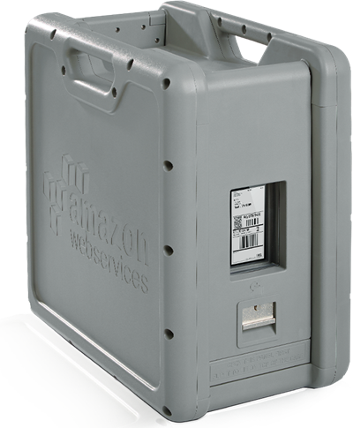
Snowball
Snowball is a petabyte-scale data transport solution that uses secure appliances to transfer large amounts of data into and out of the AWS cloud.
Using Snowball addresses common challenges with large-scale data transfers including high network costs, long transfer times, and security concerns. Transferring data with Snowball is simple, fast, secure, and can be as little as one-fifth the cost of high-speed Internet.
256 bit encryption
Data is encrypted by the Snowball client before it reaches the Snowball
Keys are managed by AWS KMS and never sent to the Snowball
Built to handle “Cyber Attack”

Slide 3
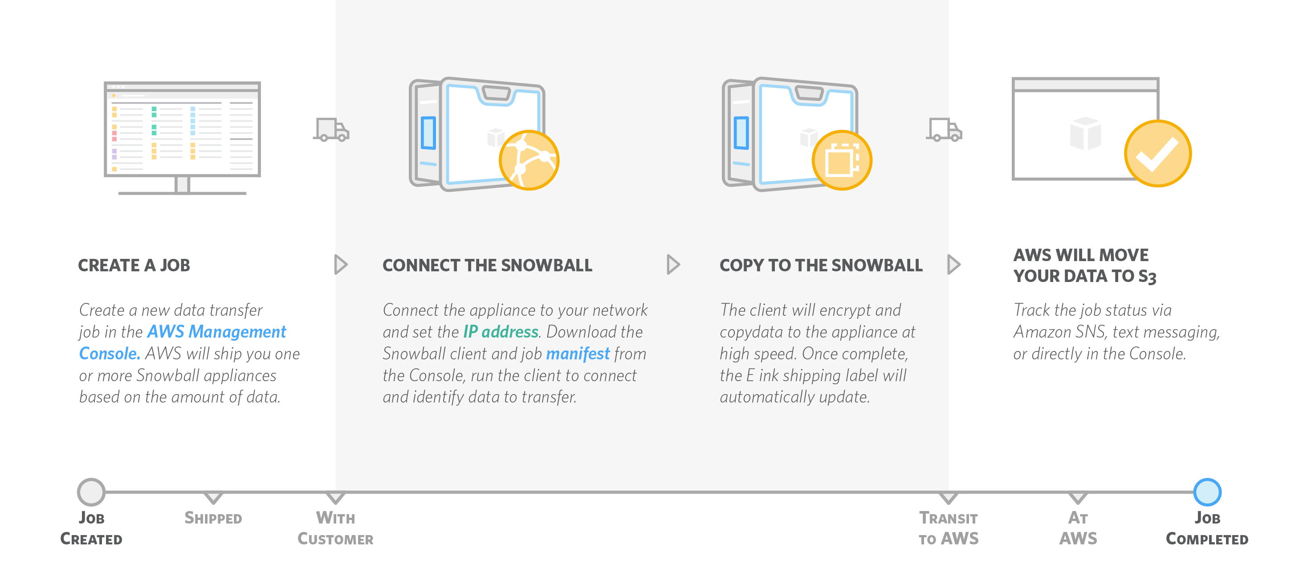
How it Works ?

Slide 4

AWS Snowball Edge
AWS Snowball Edge is a 100TB data transfer device with on-board storage and compute capabilities.
You can use Snowball Edge to move large amounts of data into and out of AWS, as a temporary storage tier for large local datasets, or to support local workloads in remote or offline locations.
Local Compute equivalent to an Amazon EC2 m4.4large instance
Snowball Edge connects to your existing applications and infrastructure using standard storage interfaces, streamlining the data transfer process and minimizing setup and integration.
Snowball Edge can cluster together to form a local storage tier and process your data on-premises, helping ensure your applications continue to run even when they are not able to access the cloud.

Slide 5
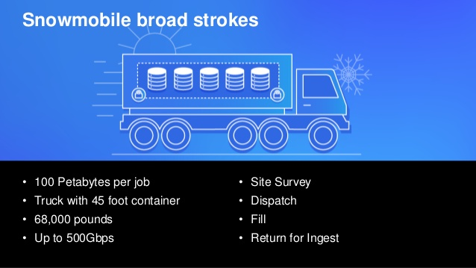
AWS SnowMobil

Slide 6
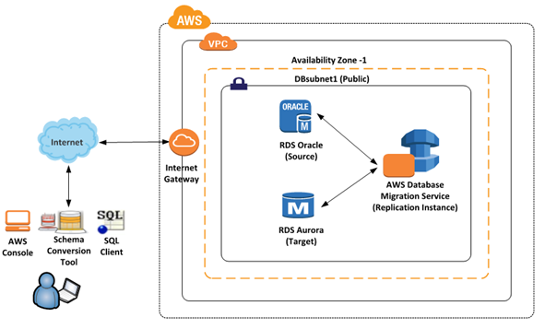
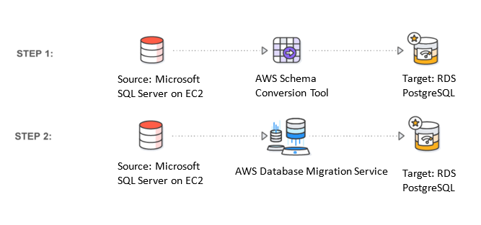
AWS Database migration Service (DMS)
AWS Database Migration Service helps you migrate databases to AWS quickly and securely. The source database remains fully operational during the migration, minimizing downtime to applications that rely on the database.
The AWS Database Migration Service can migrate your data to and from most widely used commercial and open-source databases.
The service supports homogenous migrations such as Oracle to Oracle, as well as heterogeneous migrations between different database platforms, such as Oracle to Amazon Aurora or Microsoft SQL Server to MySQL.
It also allows you to stream data to Amazon Redshift, Amazon DynamoDB, and Amazon S3 from any of the supported sources including Amazon Aurora, PostgreSQL, MySQL, MariaDB, Oracle, SAP ASE, SQL Server and MongoDB, enabling consolidation and easy analysis of data in the petabyte-scale data warehouse. AWS Database Migration Service can also be used for continuous data replication with high-availability.

Slide 7
AWS Disaster Recovery
Business Continuity: Ensuring that your organization’s mission critical business functions continuing to operate or they recover pretty quickly from a serious incidence.
Disaster Recovery: Disaster recovery is all about preparing for and recovering from a disaster, so any event that has a negative impact on your business; things like hardware failures; software failures; power outages; physical damages to your building like fire, flooding, and hurricanes or even human error. Disaster recovery is all about planning for those incidents.
Recovery Point Objectives (RPO): RPO is basically the acceptable amount of data loss measured in time. If your disaster hits at 12:00 PM and your RPO is one hour, your system should recover all the data that was in the system before 11:00 AM. Your data loss will only span from 11:00 AM to 12:00 PM.
Recovery Time Objective (RTO): RTO is the time it takes after a disruption to restore your business processes back to their agreed upon service levels. If your disaster occurs at 12 p.m. and your RTO is eight hours, you should be back up and running by no later than 8:00 p.m.

Slide 8
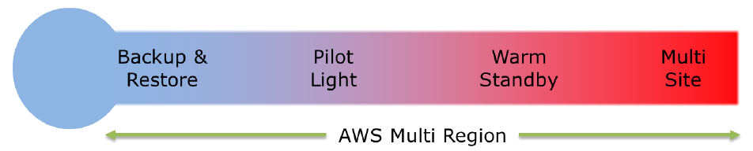
AWS Disaster Recovery
Backup and Restore: Pretty common solution for on-premises infrastructure. Data is backed up to tapes or some other remote storage, AWS can also act as that “remote storage”
Pilot Light: Based on idea of having little “something” in a remote location that will help us to speed up recovery process in case of disaster, for example, it can be a copy of Database running in another region
Warm Standby: This solution extends the pilot light elements and preparation. It further decreases the recovery time (RTO) because some services are always running.
Multi site: Full copy of infrastructure in another region. Don’t want to deep into details here, since name of this strategy pretty much explains itself.

